Slide 1
GROUP 8
NAME | STUDENT NUMBER | REGISTRATION NUMBER
KIMWERO DICKSON | 16/U/441 | 216000635
NANSAMBA NULUYATI | 14/U/12656/EVE | 214004137
LUMALA DAVID
MUSABA IVAN | 14/U/9961/EVE | 214016818

Slide 2
UNSUPERVISED LEARNING
This is one of the parts of machine learning.
Unsupervised learning deals mainly with finding hidden patterns/intrinsic structures in the data mostly unlabeled data without trying to make predictions.
Unlabeled data just simply consists of samples of natural or human created artifacts that we can obtain relatively easily from the world eg photos , news articles etc.
It draws inferences from datasets consisting of input data without labelled responses.
We use cluster analysis for exploratory data analysis to find hidden patterns or groupings in the data

Slide 3
GOALS
Finding homogeneous sub groups within a large group for example if we have one big group of six people, we find the ones with common features and group them i.e clustering
Finding patterns in the features of data
We can use dimensionality Reduction
Decreasing the number of features to describe an observation while maintaining the maximum information content under the constraints of low dimensionality ie compression
Visualize high dimensional data.. This is done while maintaining much data viability
Its also a preprocessing step for supervised learning

Slide 4
Challenges and Benefits
No single goal of analysis
Requires more creativity of the analyst
There is much more unlabeled data available than there is clearly labelled data.

Slide 5
continuation
Unsupervised learning is about clustering. There
are several types of clustering
We are mainly going to talk about 2 here
k-means clustering
Hierarchical clustering

Slide 6
K-means clustering
Its used to find homogeneous subgroups within a population. It breaks the observations into predefined number of clusters ie K clusters
Groups are defined by creating a centroid for each group. The centroids are like the heart of the cluster and they capture the points closest to them and add them to the cluster
It uses a function kmeans() that specifies how many clusters you would like to perform
We are going demonstrate using a reduced version of mtcars from R’s datasets package where we remove two undefined variables from the data set.
Below is the piece of code.

Slide 7
Continuation
require("datasets") # This loads the datasets package.
mtcars1 <- mtcars[, c(1:4, 6:7, 9:11)] # New object, select variables.
mtcars1[1:3, ] # Show the first three lines of the new object.
Remember kmeans() function specifies the number of clusters we want hence if we need 3 clusters then we use
km <- kmeans(mtcars1, 3) # Specify 3 clusters
We run km to view the outputs.

Slide 8
continuation
But at this point as you can see, the clusters are better off in a graph format. But kmeans() function doesn’t do this by default.
We use the clusplot() function form the cluster package.
require("cluster") #loads cluster package
clusplot(mtcars1, # Data frame
km$cluster, # Cluster data
color = TRUE, # Use color
shade = FALSE, # Colored lines in clusters (FALSE is default).
lines = 3, # Turns off lines connecting centroids.
labels = 2) # Labels clusters and cases.

Slide 9
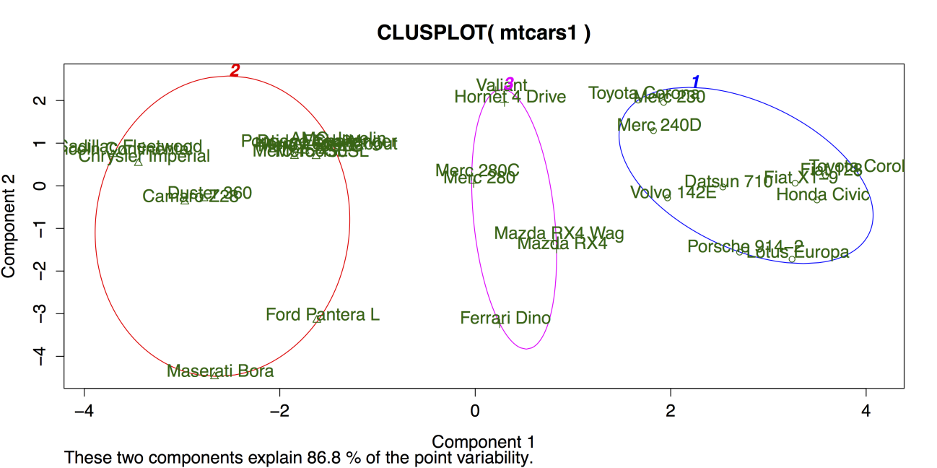
Cluster plot for K-means clustering.

Slide 10
continuation
As you can see there is a good separation between the clusters by the colored circles but the cluster number 2 on the extreme left suggests that more than two maybe needed due to the separation between the elements in the cluster.
For checking on the number and size of the clusters we can use hierarchical clustering.

Slide 11
Why k means clustering
Its simple that is its easy to understand and implement
Its efficient as compared to the rest
It’s the most popular

Slide 12
Hierarchical clustering
Here we produce a nested sequence of clusters like a tree as shown in the following slides
Here each case starts by itself and then the cases are gradually joined together according to their similarity
Here we use the hclust()function but it doesn’t run on the raw data frame , it Instead needs the distance or dissimilarity matrix which uses the dist() function.
Run both and produce a dendrogram using the plot()function on the model generated by hclust()

Slide 13
continuation
d <- dist(mtcars1) # Calculate the distance matrix.
c <- hclust(d) # Use distance matrix for clustering.
plot(c) # Plot a dendrogram of clusters.

Slide 14
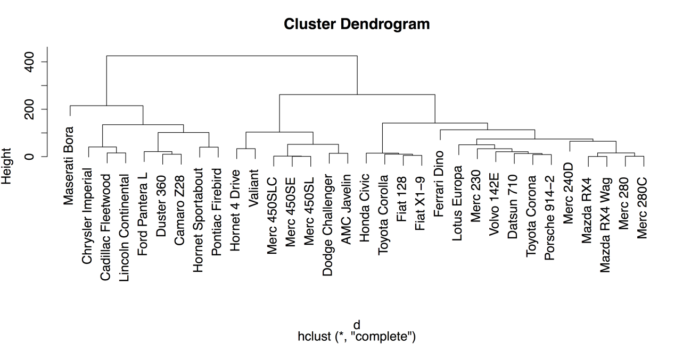
Cluster dendrogram

Slide 15
Cont..
The lines above join each case to other similar cases while cases that are more similar are joined lower down eg Mercedes-benz 280 and 280C on the far right and the cases that are more different are joined higher up eg its clear that Mercerati Bora on the far left is different from every car in the dataset .
Further more after hierarchical model has been calculated its possible to place the observations into groups using the cutree() function which represents a cut tree diagram
Cutree() functions takes two parameters where to cut and the number of groups for example

Slide 16
continuation
g3 <- cutree(c, k = 3) # "g3" = "groups: 3"
g3[30:32] # Show groups for the last three cases.
you can also draw boxes around the groups in the dendrogram
Using the rect.hclust() function
rect.hclust(c, k = 2, border = "gray")
rect.hclust(c, k = 3, border = "blue")
rect.hclust(c, k = 4, border = "green4")
rect.hclust(c, k = 5, border = "red")

Slide 17
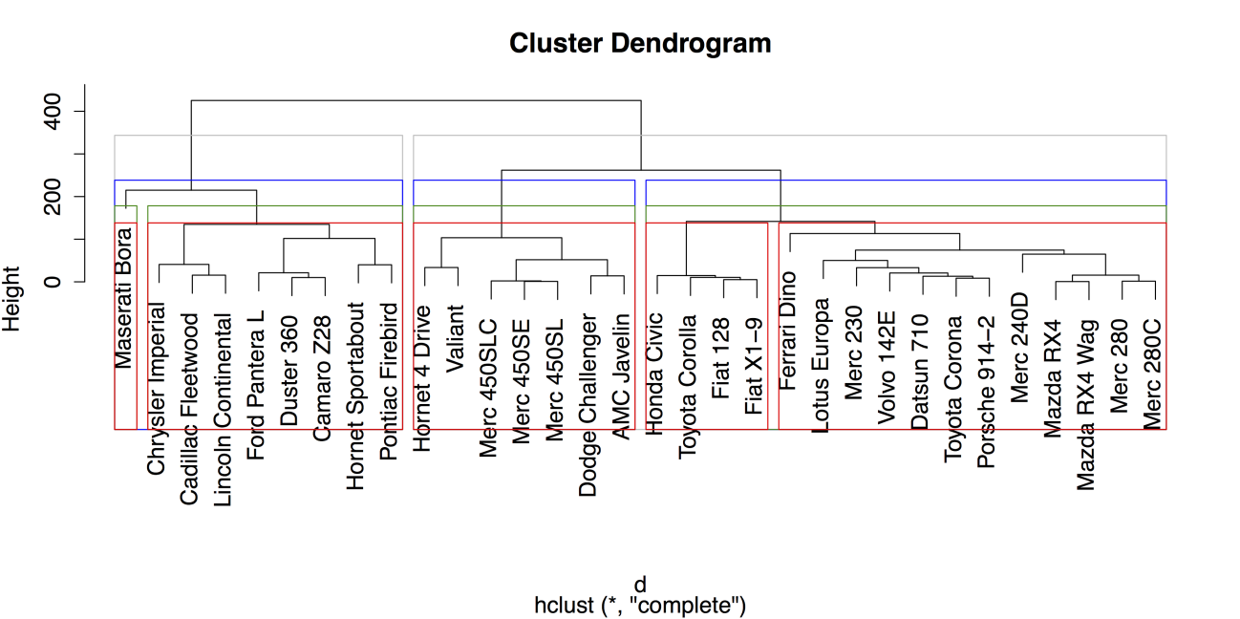
Cont..

